Slide 1
Tutorial 6

Slide 2
Question 1: The clock, J and K inputs to a negative edge-triggered JK flip-flop are given below. Plot the corresponding output waveforms, Q. Assume Q is initially 0.
Question 2: A level-triggered D latch is made up of two latches as shown. With the aid of a timing diagram, show that the flip-flop senses the input data present after the rising edge of the clock and producing a corresponding output.

Slide 3
Question 3: A latch can be constructed from two NAND gates connected as follows:
(a)What restrictions must be places on S* and R* so that P will always equal to Q’ (under steady state conditions)?
(b) Construct the next-state table and derive the characteristics equation for the latch.
(c) Complete the following timing diagram for the latch.
(d) What is the relation between S* and R* in this question and the S and R inputs for the cross coupled NOR S-R latch?

Slide 4
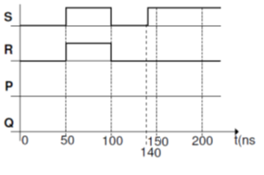
Question 4: Complete the following timing diagram for the figure below, assuming that each gate has a propagation delay of exactly 10ns. Assume initially P = 1 and Q = 0.
Question 5: Complete the following timing
diagram for a negative edge-triggered JK
flip-flop with active low asynchronous
preset and clear inputs.

Slide 5
Question 6: Complete the timing diagram for the following circuit.
Question 7: A circuit comprises a synchronous T flip-flop, TFF₀, driven by input I. Its output Q₀ drives a D flip-flop, DFF₁ whose output Q₁ drives another synchronous T flip-flop, TFF₂ with output Q₂. Determine the sequence of outputs on Q₂ Q₁ Q₀ starting from 0 0 0 that occur when I is set to ‘1’ and the circuit clocked.

Slide 6
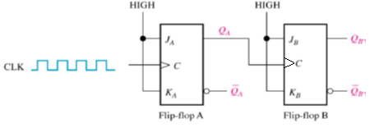
Question 8: The JK flip-flop resolves the ‘not allowed’ input condition where S = R = 1 in a simple SR flip-flop. Another way to resolve it would be to add some external logic so that this condition, the Set signal “1” (and Reset = 0 is applied to the flip-flop). Design the external logic needed to achieve this.
Question 9: Show the Q output of flip-flops below in proper relation to the clock. The flip-flops are initially RESET.

Slide 7
Question 10: For the circuit below, develop a timing diagram for eight clock pulses, showing the QA and QB outputs in relation to the clock.

